Slide 1
Automatic Extraction of Phrase-Level Map Labels from Historical Maps
Haowen Lin
Computer Science Department

Slide 2
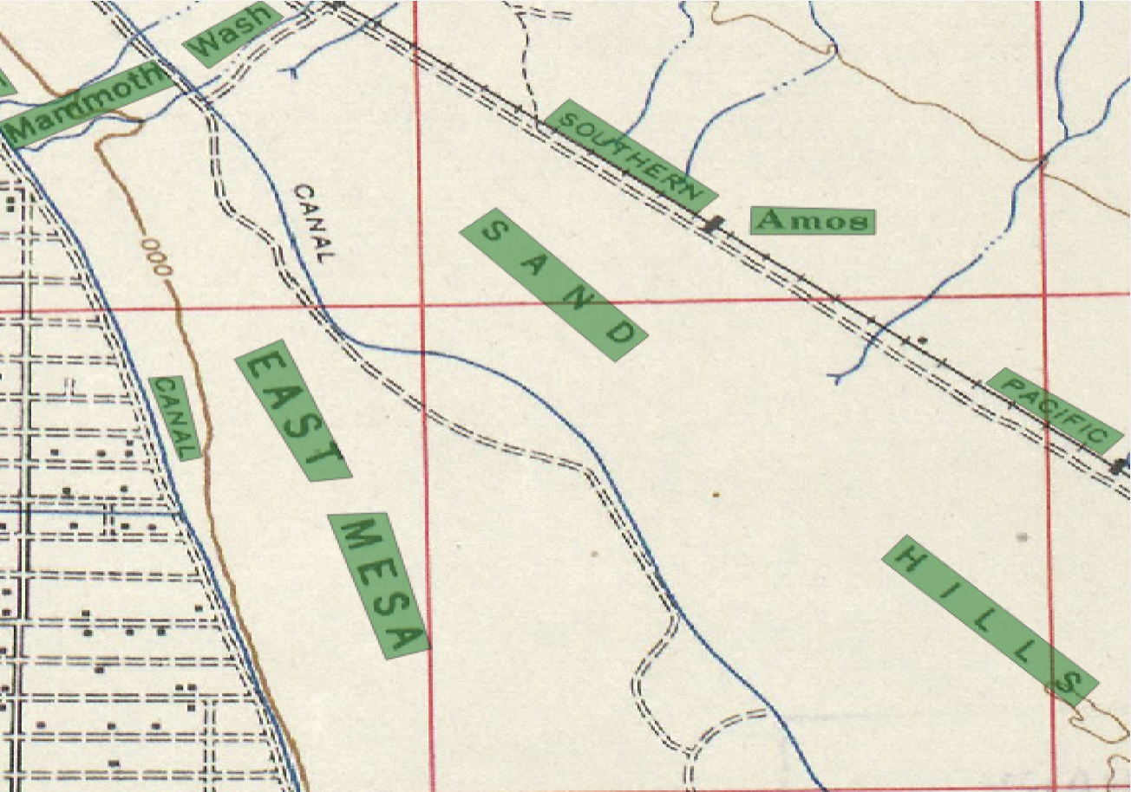
Motivation
Textual information is used for -searching -building comprehensive gazetteer
However, we only get separated bounding boxes from OCR scanning and manual digitalization

Slide 3
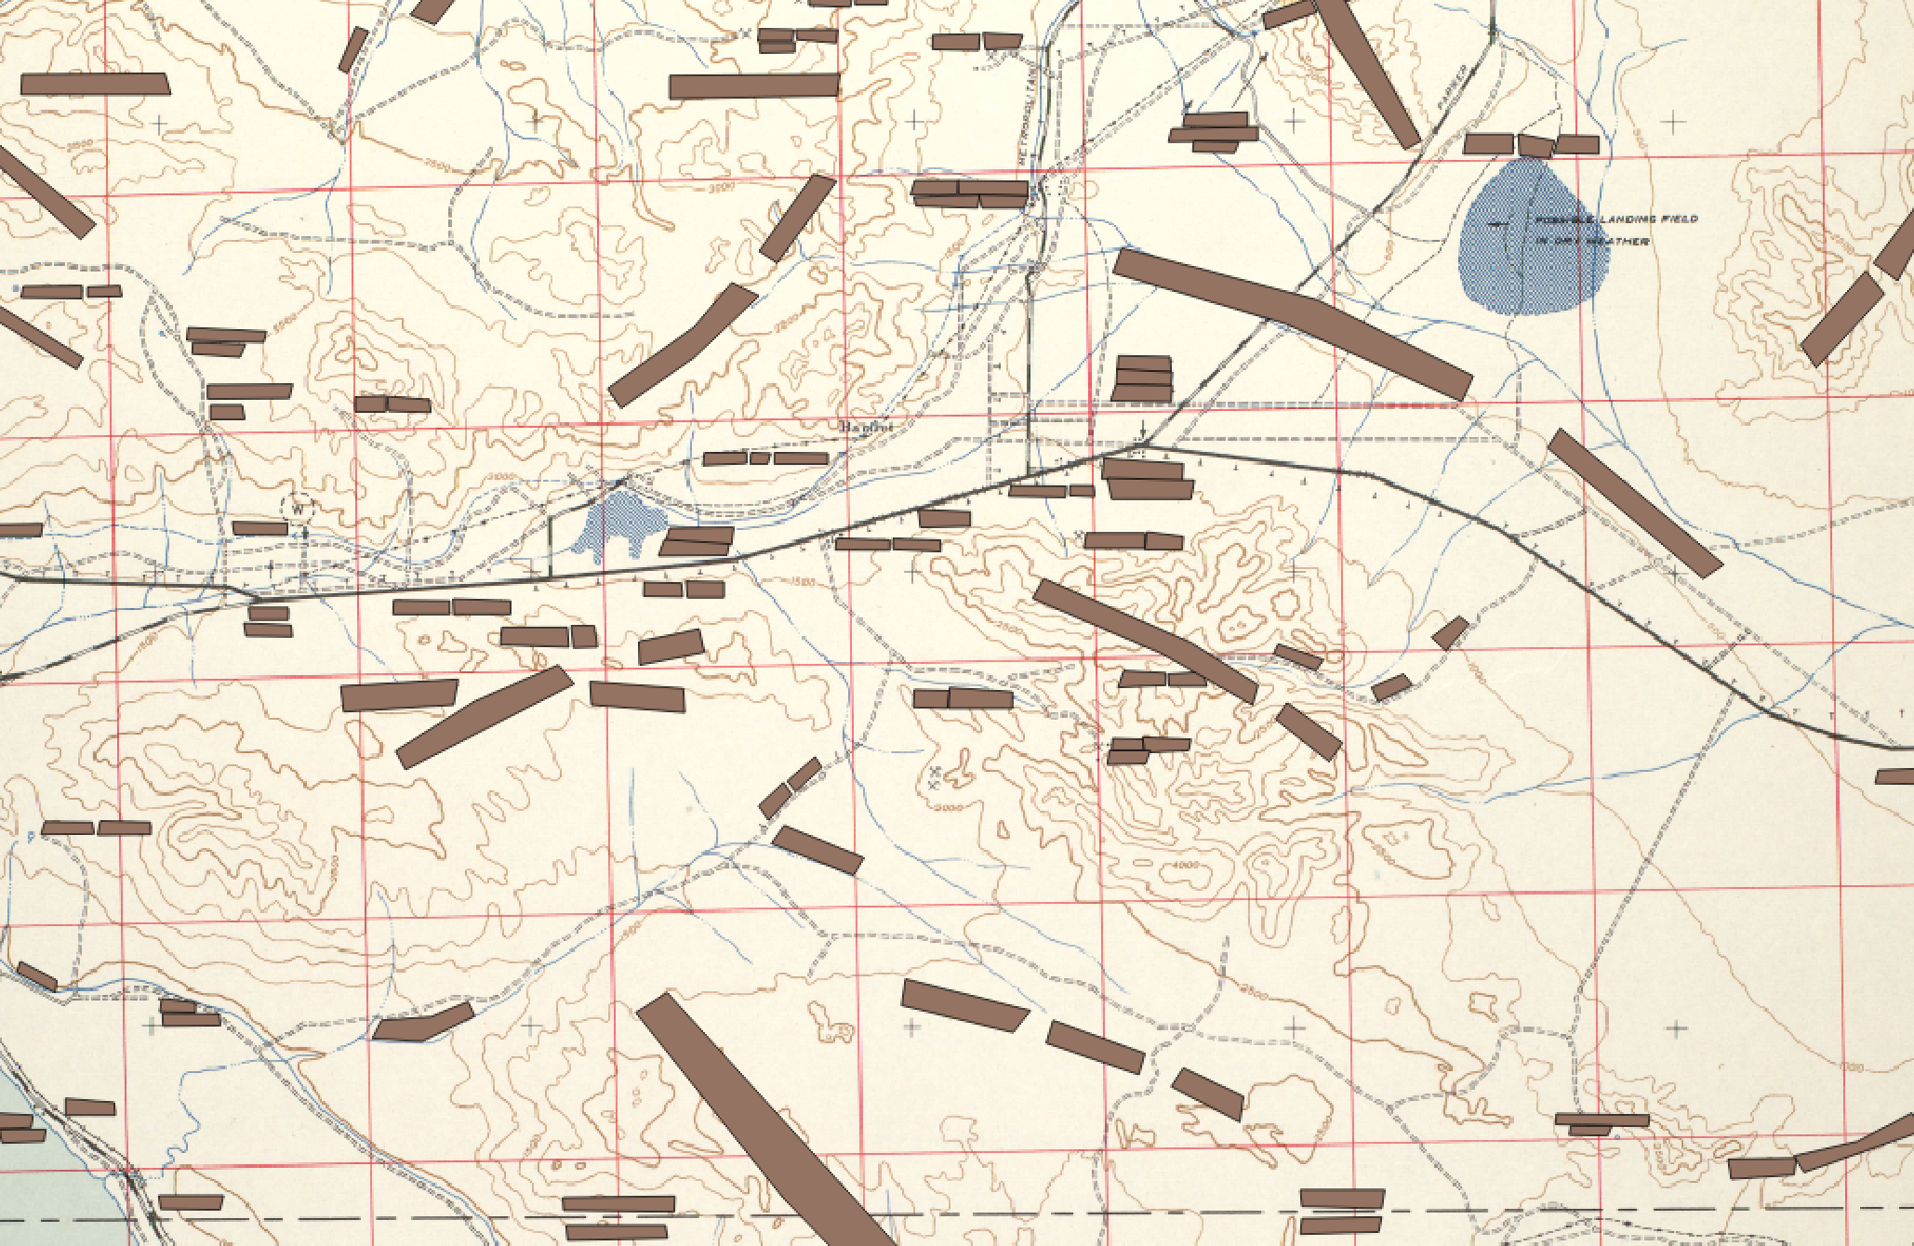
Challenges

Slide 4
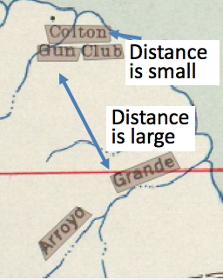
Feature Generation
1. Boundary Distance
Compute the distance between every line segment
Word from same phrases: boundary distance is small; Words from different phrases: boundary distance is large
Boundary Distance

Slide 5
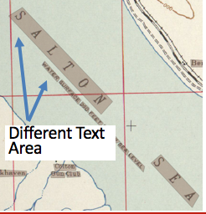
Feature Generation
2. Character Spacing
Map labels have various text sizes
Words from same phrases have similar character spacing

Slide 6
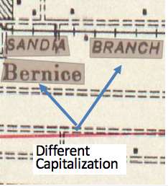
Feature Generation
3. Capitalization
Three kinds of capitalization: 1) All uppercase 2) All lowercase 3) Combinations of uppercase and lowercase
Words in same phrases must have same capitalization

Slide 7
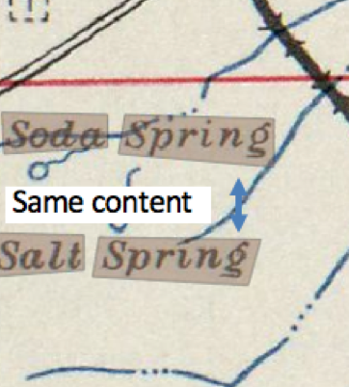
Feature Generation
4. Textual Content
Same words must come from separate phrases

Slide 8
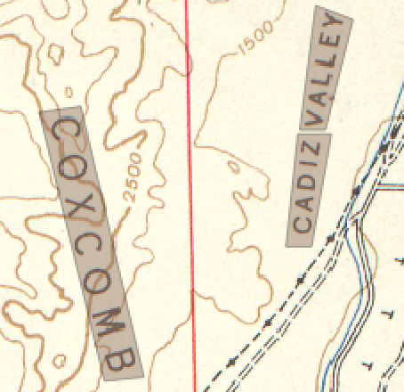
Support Vector Machine
Training and testing between every pair of polygons on the maps
Feature vector: [Text Ratio, Boundary Distance]
Output : the actual linkage between every pair of polygons
Notes:
What’s the input or what’s the output

Slide 9
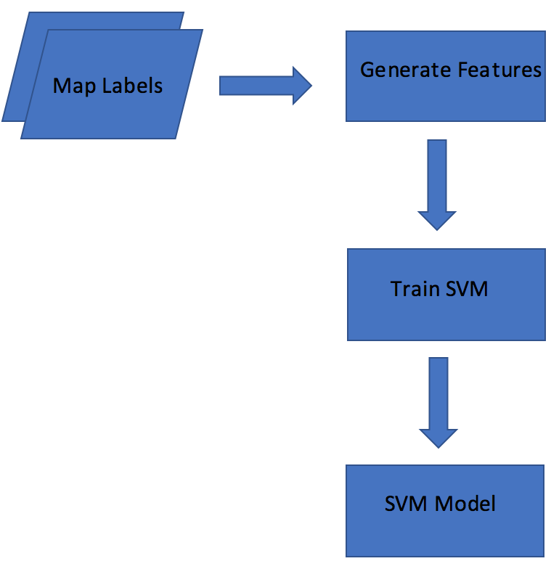
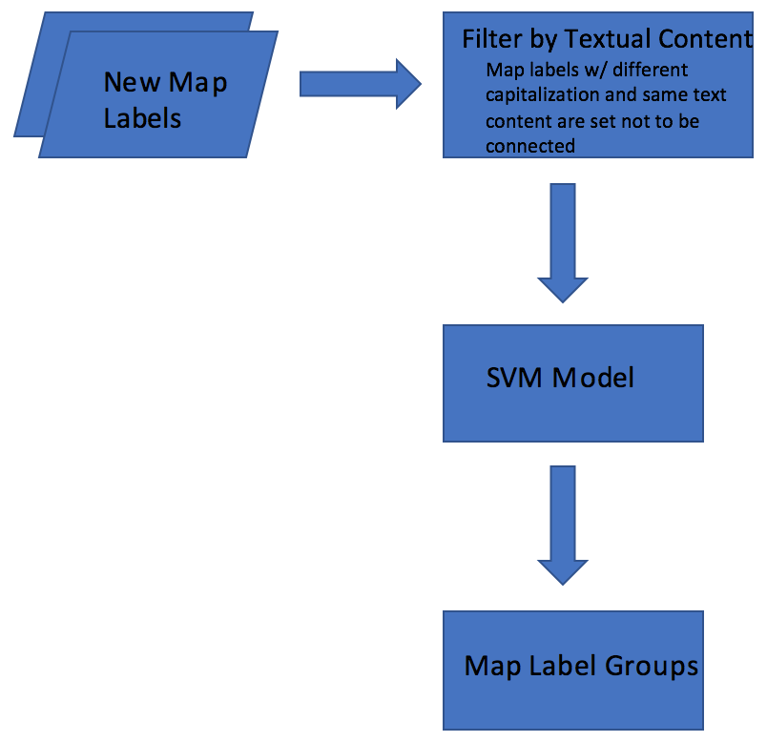
Data Flow

Slide 10
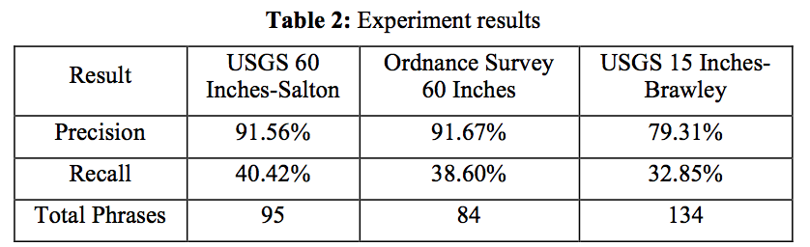
Experiment Results
Evaluation Metric:
Precision
Recall
Result | USGS 60 Inches-Salton | Ordnance Survey 60 Inches | USGS 15 Inches-Brawley
Precision | 91.56% | 91.67% | 79.31%
Recall | 40.42% | 38.60% | 32.85%
Total Phrases | 95 | 84 | 134

Slide 11
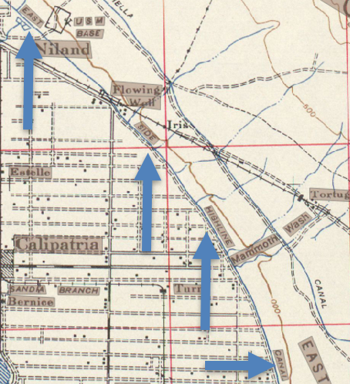
Summary and Future work
Polygons with huge distance/text area differences are still connected Solution: 1) Iterative training 2) Check linkages after removing connected polygons
Imbalanced data for the training model Solution: 1) Increase misclassification penalty for true connections 2)Resampling dataset

Slide 12
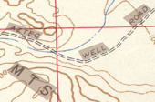
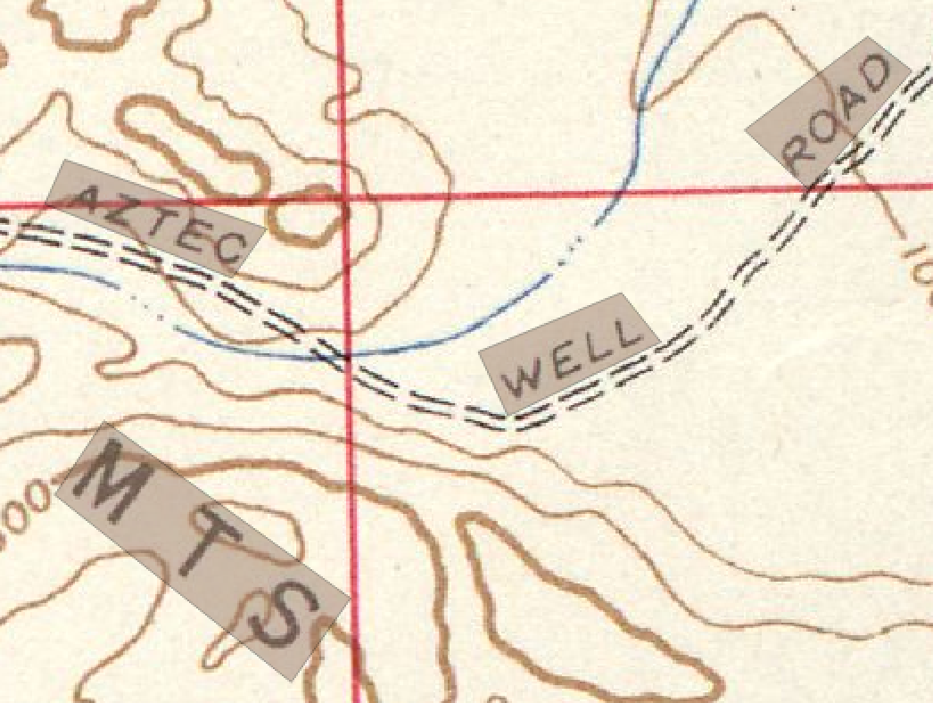
Summary and Future work
Adding more features Example: Orientation of polygons :
Using minimum bounding boxes to
decide orientation

Slide 13
Thank you!
Haowen Lin, haowenli@usc.edu
Computer Science Department
University of Southern California

